Slide 1
Biology
Sylvia S. Mader
Michael Windelspecht
Chapter 28
Invertebrate Evolution
Lecture Outline
See separate FlexArt PowerPoint slides for all figures and tables pre-inserted into PowerPoint without notes.
Copyright 2022 © McGraw Hill LLC. All rights reserved. No reproduction or distribution without the prior written consent of McGraw Hill LLC.

Slide 2
Outline
28.1 Evolution of Animals
28.2 The Simplest Invertebrates
28.3 Diversity Among the Spiralians
28.4 Diversity of the Ecdysozoans
28.5 Invertebrate Deuterostomes

Slide 3
28.1 Evolution of Animals
All animals are multicellular and heterotrophic, which means they must acquire nutrients from an external source.
  Fungi digest their food externally and absorb nutrients.
  Animals ingest (eat) whole food and digest internally.
Animals have a variety of life cycles.
  Many reproduce sexually, some asexually, and some combine both life cycles.
  Many animals have a diploid life cycle.
Animals are descended from a single common ancestor.
Within the animal lineage are two main branches: invertebrates and vertebrates.
Vertebrates are animals that at some stage have a spinal cord (backbone), whereas invertebrates do not.
3

Slide 4
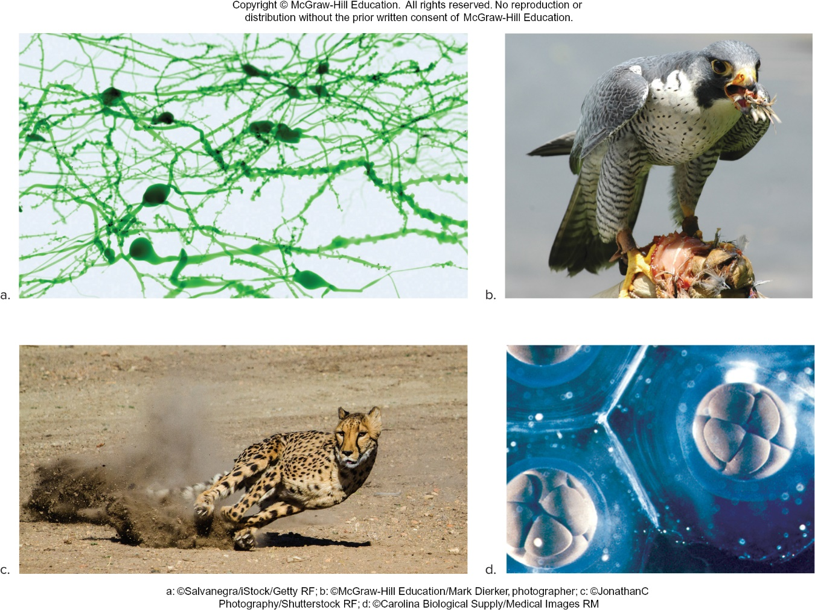
Common Features of Animals
Figure 28.1
(a): Salvanegra/iStock/Getty Images; (b): Mark Dierker/McGraw-Hill; (c): JonathanC Photography/Shutterstock; (d): Carolina Biological/Medical Images
4

Slide 5
Ancestry of Animals
  The colonial flagellate hypothesis
    Animals are descended from an ancestor resembling a hollow spherical colony of flagellated cells.
    Among protists, the choanoflagellates most resemble the last single-celled ancestor of animals.
      A choanoflagellate is a single cell with a flagellum.
    The transition from colonial flagellates to multicellular animals may have begun by aggregation of a few flagellated cells.
    Individual cells within the colony may have specialized.
    Two tissue layers may have arisen by infolding of certain cells into a hollow sphere.
    This hypothesis is attractive because of its implications regarding animal symmetry.
5

Slide 6
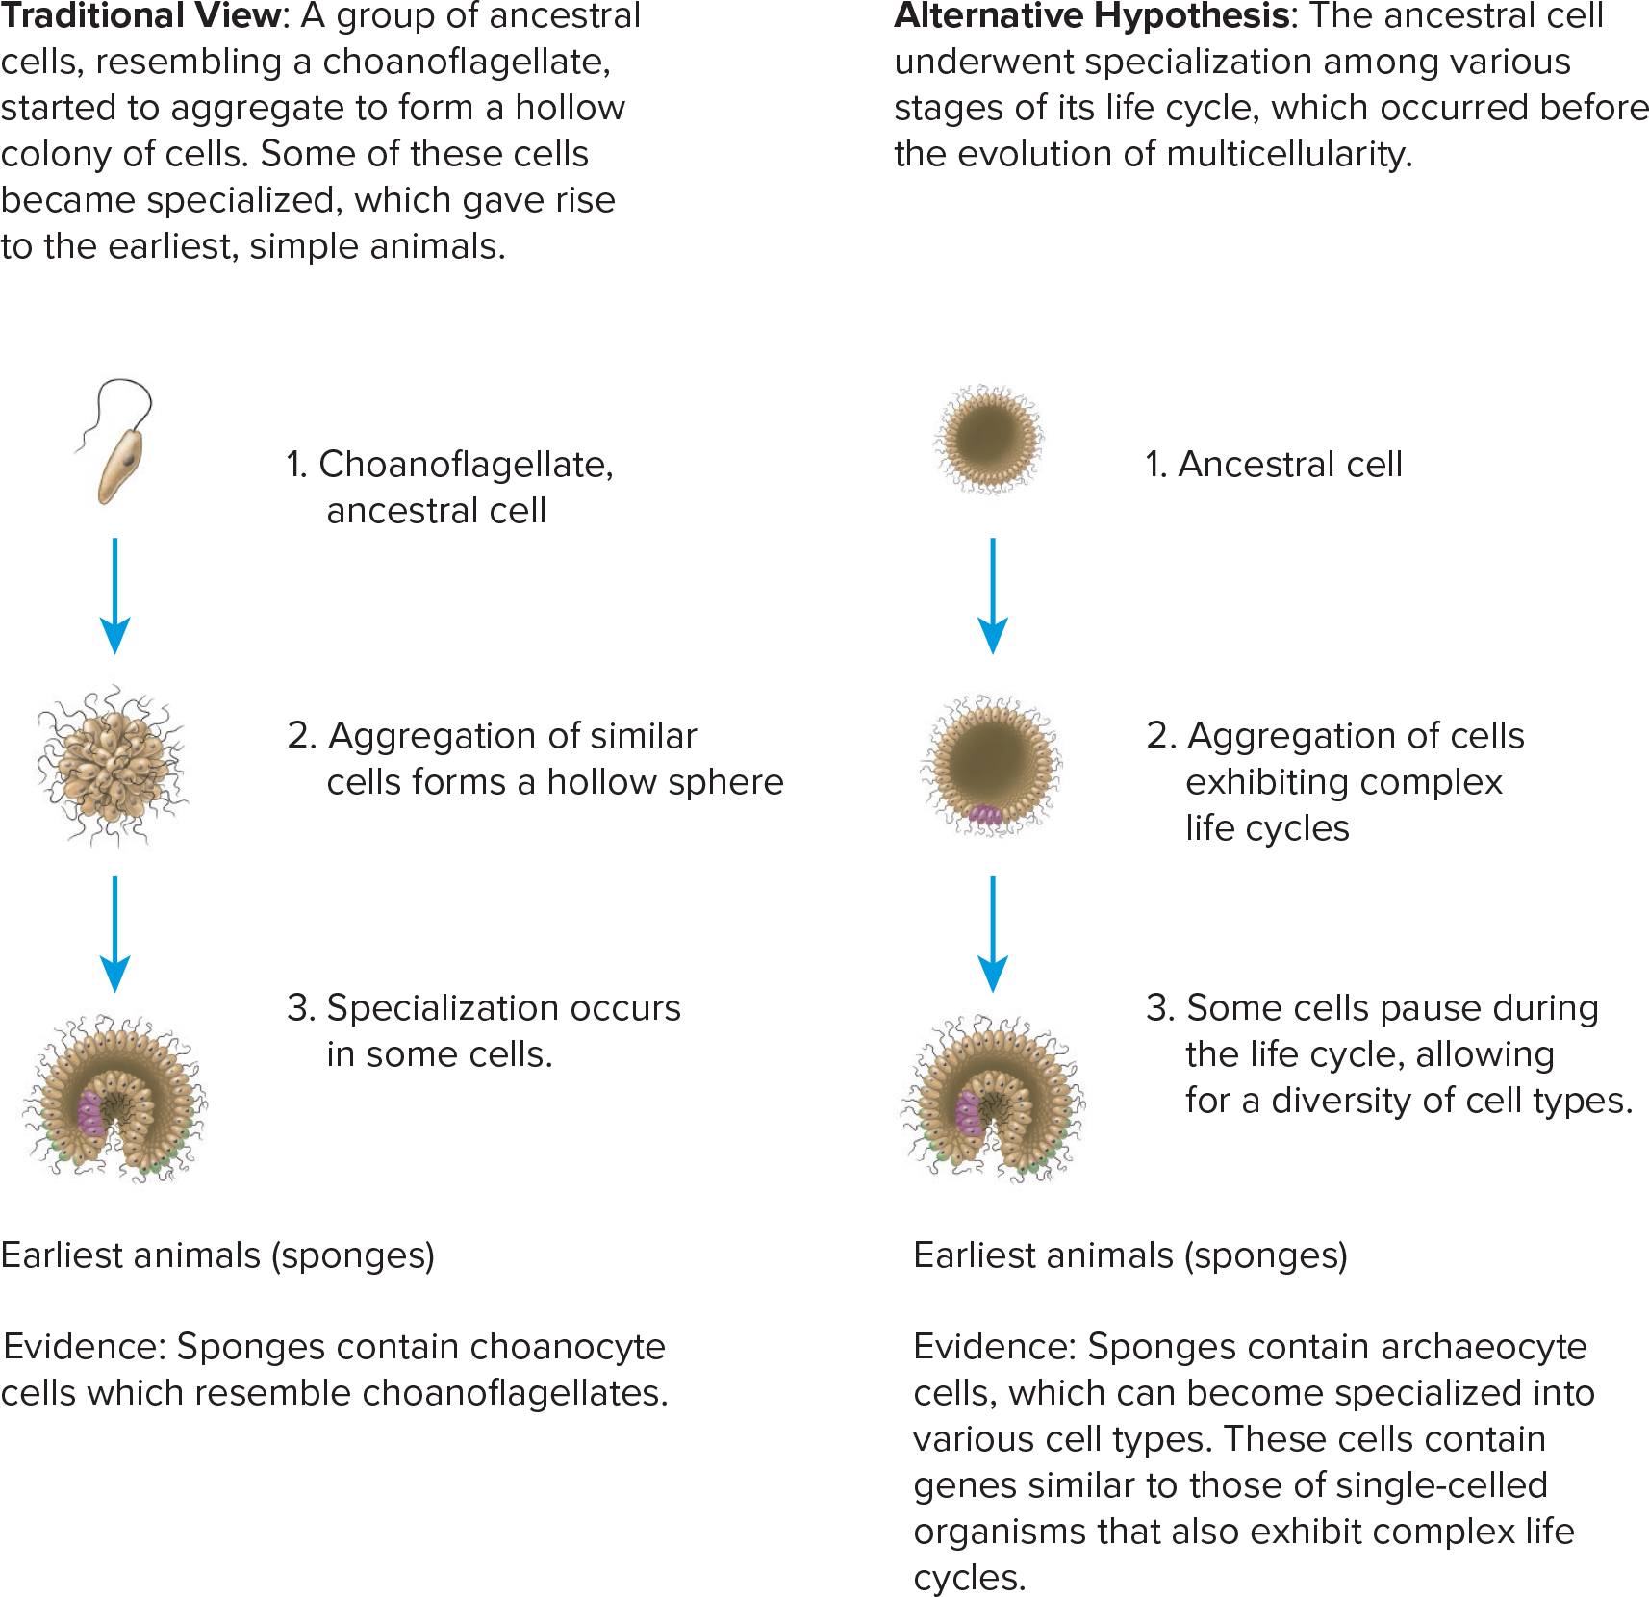
Hypotheses on the Evolution of Early Animals
Figure 28.2
Access the text alternative for slide images.
6

Slide 7
Evolution of Body Plans
  All the diversified body plans characteristic of animals today were present by the Cambrian period.
    Different combinations of numbers, positions, sizes, and patterns of body parts could have led to the great variety of animal forms in the past and present.
    Slight shifts in the DNA code and expression of Hox (homeotic) genes may have been responsible for the differences that arise during development.
7

Slide 8
The Phylogenetic Tree of Animals
  Symmetry – A pattern of similarity that is observed in objects
    Three types of symmetry in animal kingdom
      Asymmetry – No particular body shape (for example sponge).
      Radial symmetry – Two identical halves (for example jellyfish)
        Enables an animal to reach out in all directions from one center
      Bilateral symmetry – Definite right and left halves
        Animals tend to be active and to move forward at an anterior end.
        The localization of the brain and sensory organs at the anterior end is called cephalization.
8

Slide 9
Embryonic Development
  The first tissue layers that appear are called germ layers.
      These give rise to organs and organ systems.
    Diploblastic – Two tissue layers
    Triploblastic – Three tissue layers
      Protostomes – First embryonic opening becomes the mouth
      Deuterostomes – Second embryonic opening becomes the mouth
9

Slide 10
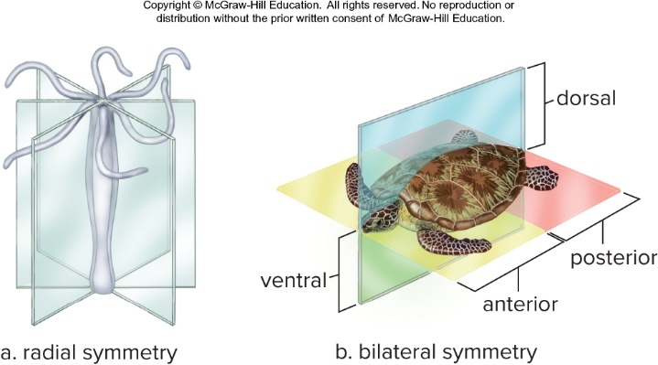
Symmetry in Animals
Figure 28.4
10

Slide 11
Protostomes Versus Deuterostomes
  Cleavage – Cell division without growth
    Protostomes – Spiral cleavage
    Deuterostomes – Radial cleavage
  Blastula
    Protostomes – First opening becomes the mouth.
    Deuterostomes – First opening becomes the anus, and the second opening becomes the mouth.
  Certain protostomes and all deuterostomes have a true coelom.
    Protostomes – Coelom forms by a splitting of the mesoderm.
    Deuterostomes – Coelom forms by an outpocketing of primitive gut.
11

Slide 12
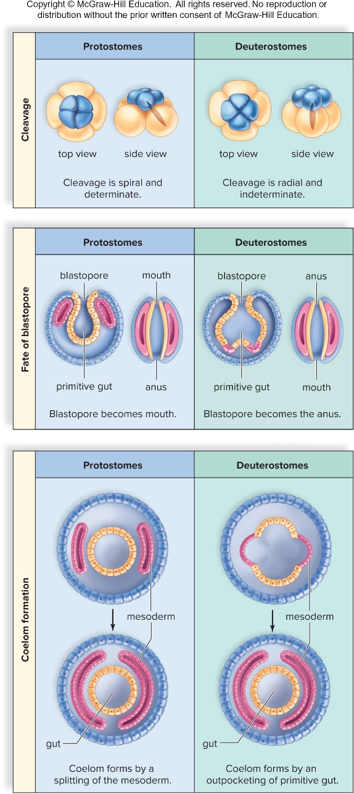
Protostomes Compared to Deuterostomes
Figure 28.5
Access the text alternative for slide images.
12

Slide 13
28.2 The Simplest Invertebrates
Sponges lack true tissues and have a cellular level of organization.
    Have only a few cell types
  Saclike bodies are perforated by many pores.
  Beating of flagella produces water currents that flow through pores into central cavity and out osculum.
  It is a sessile filter feeder.
  Reproduction:
    They reproduce asexually by fragmentation or by budding.
    Sexual reproduction produces a flagellated larva that may swim to a new location.
    Sponges are capable of regeneration, or growth of a whole from a small part.
13

Slide 14
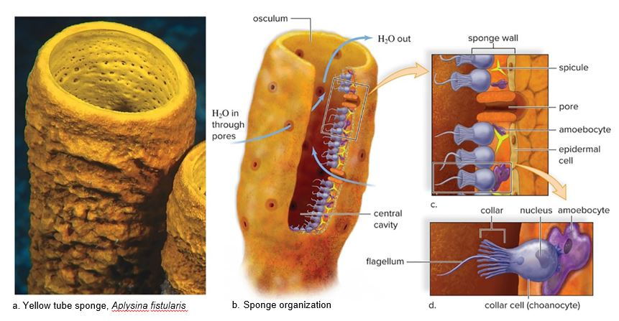
Sponge Anatomy
Figure 28.6
Access the text alternative for slide images.
(a): Andrew J. Martinez/Science Source
14

Slide 15
Ctenophora
  Comb jellies are solitary, free-swimming marine invertebrates.
  They are small, transparent, and sometimes bioluminescent.
    Bioluminescent organisms can produce their own light.
  The body is composed of mesoglea, a jellylike substance.
  Comb jellies have been shown to contain DNA sequences more ancient than sponges.
    Comb jellies may have been the first organisms to evolve.
  They are the largest animals propelled by beating of cilia.
  They capture prey with colloblasts.
15

Slide 16
Cnidarians
  Tubular animals that most often reside in shallow marine waters
    Specialized stinging cells (cnidocytes)
      Fluid-filled capsule, nematocyst
    Two-layered body sac
      Outer layer – Protective epidermis
      Inner layer – Gastrovascular cavity
    Polyp and medusa body forms
      The polyp mouth is directed upward, while the mouth of a jellyfish, or medusa, is directed downward.
16

Slide 17
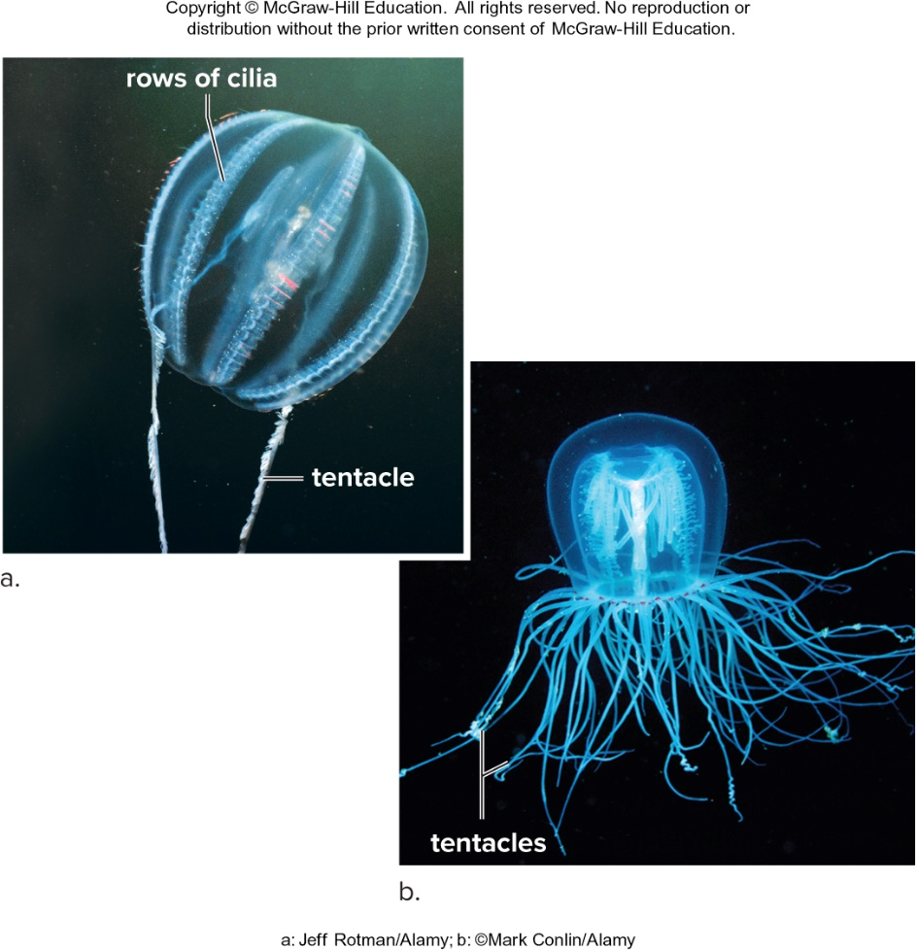
Comb Jelly Compared to Cnidarian
Figure 28.7
(a): Jeff Rotman/Alamy Stock Photo; (b): Mark Conlin/Alamy Stock Photo
17

Slide 18
Diversity of Cnidarians
Sea anemones
  Sessile polyps that live attached to a substrate
  Have upward-turned oral disk containing mouth surrounded by tentacles containing nematocysts
Corals
  Like sea anemones encased in calcium carbonate
  Live in colonies and build coral reefs
    Form Great Barrier Reef along Australia’s coast and Mesoamerican Barrier Reef along Belize’s coast
18

Slide 19
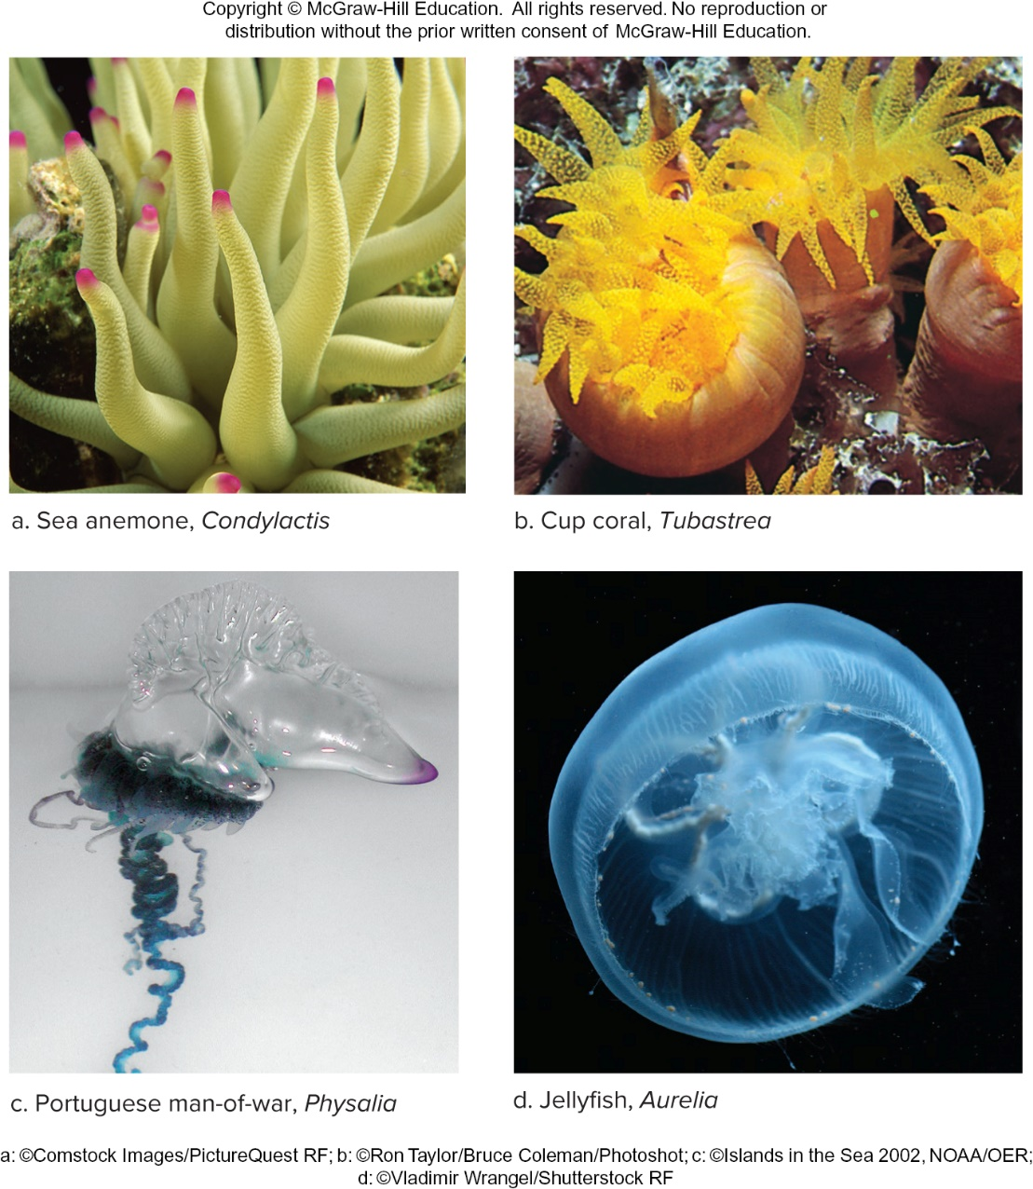
Cnidarian Diversity
Figure 28.8
(a): Comstock Images/PictureQuest/Getty Images; (b): Ron Taylor/Bruce Coleman/Photoshot; (c): Source: Image courtesy of Islands in the Sea 2002, NOAA/OER; (d): Vladimir Wrangel/Shutterstock
19

Slide 20
Hydra and True Jellyfish
Hydra
  Freshwater cnidarian
    Small tubular poly body about one-quarter inch in length
      Gastrovascular cavity is central cavity
    Tentacles can respond to stimuli.
    Can reproduce sexually and asexually
    Nerve net
      Interconnected nerve cells
True jellyfish (sea jellies)
  Medusa is primary stage and polyp remains small
  Feed on invertebrates and are food for marine animals
20

Slide 21
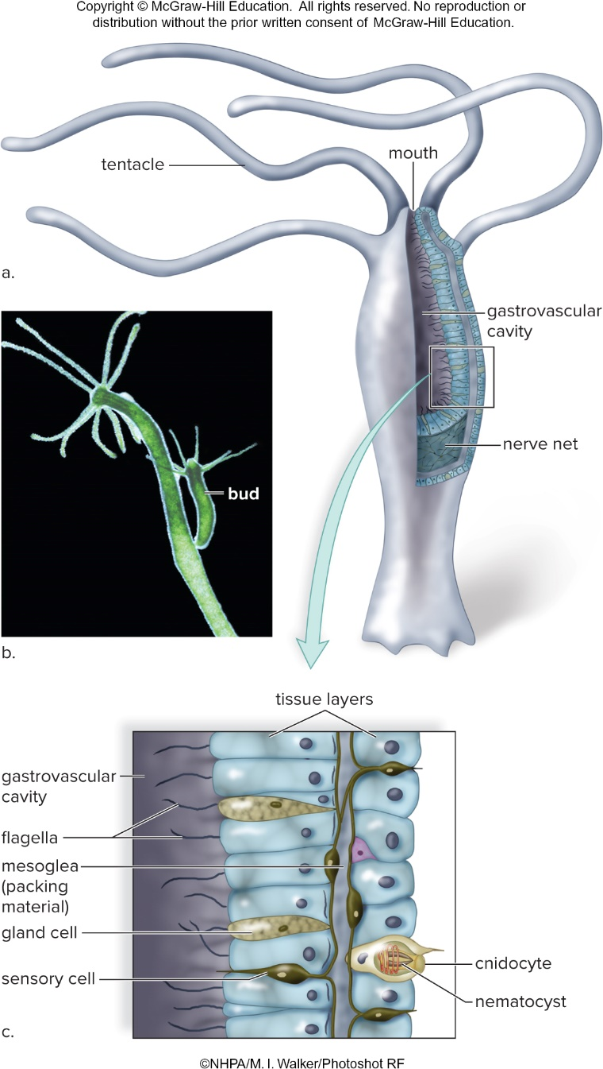
Anatomy of Hydra
Figure 28.9
Access the text alternative for slide images.
(photo): M. I. Walker/NHPA/Photoshot
21

Slide 22
28.3 Diversity Among the Spiralians
Lophotrochozoa
  Divided into two groups
    Lophophorus (bryozoans, brachiopods, phoronids)
    Protozoans (flatworms, rotifers, molluscs, annelids)
  Bilaterally symmetrical
  Embryos with three germ layers
  Protostome pattern of development
  Adults with organ level of organization
  Some with true coelom
22

Slide 23
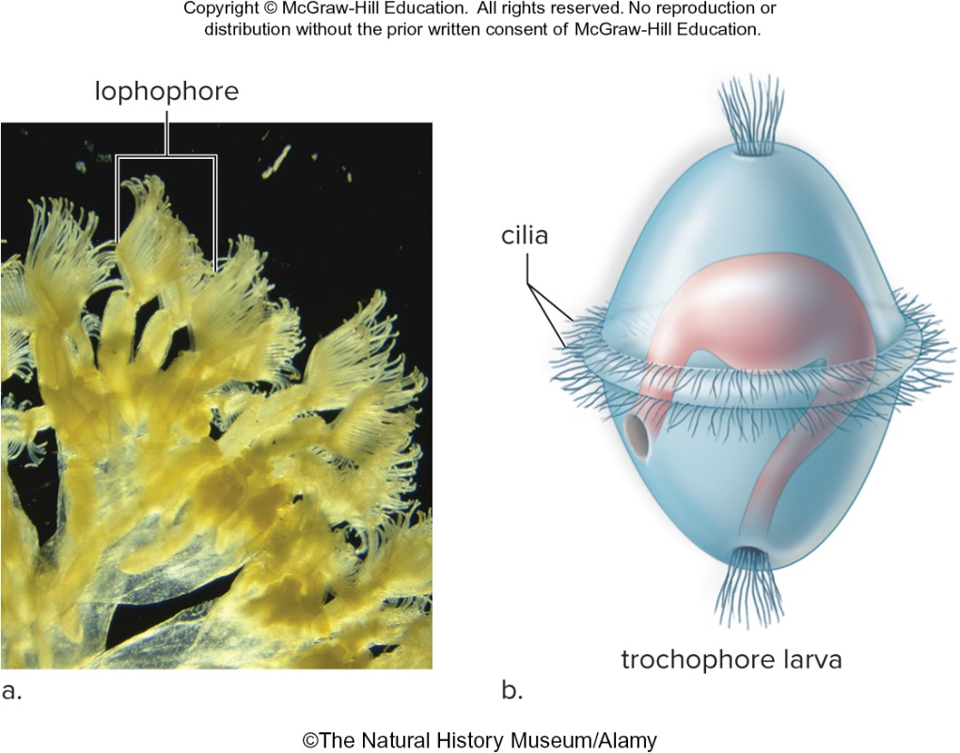
Lophotrochozoan Characteristics
Figure 28.10
(a): The Natural History Museum/Alamy Stock Photo
23

Slide 24
Trochozoans
Molluscs (phylum Mollusca)
  100,000 named species
  Have three-part body plan
    Visceral Mass
      Contains internal organs
    Mantle
      May secrete shell and/or contribute to development of gills or lungs
    Foot
      Muscle adapted for locomotion, attachment, or food capture
24

Slide 25
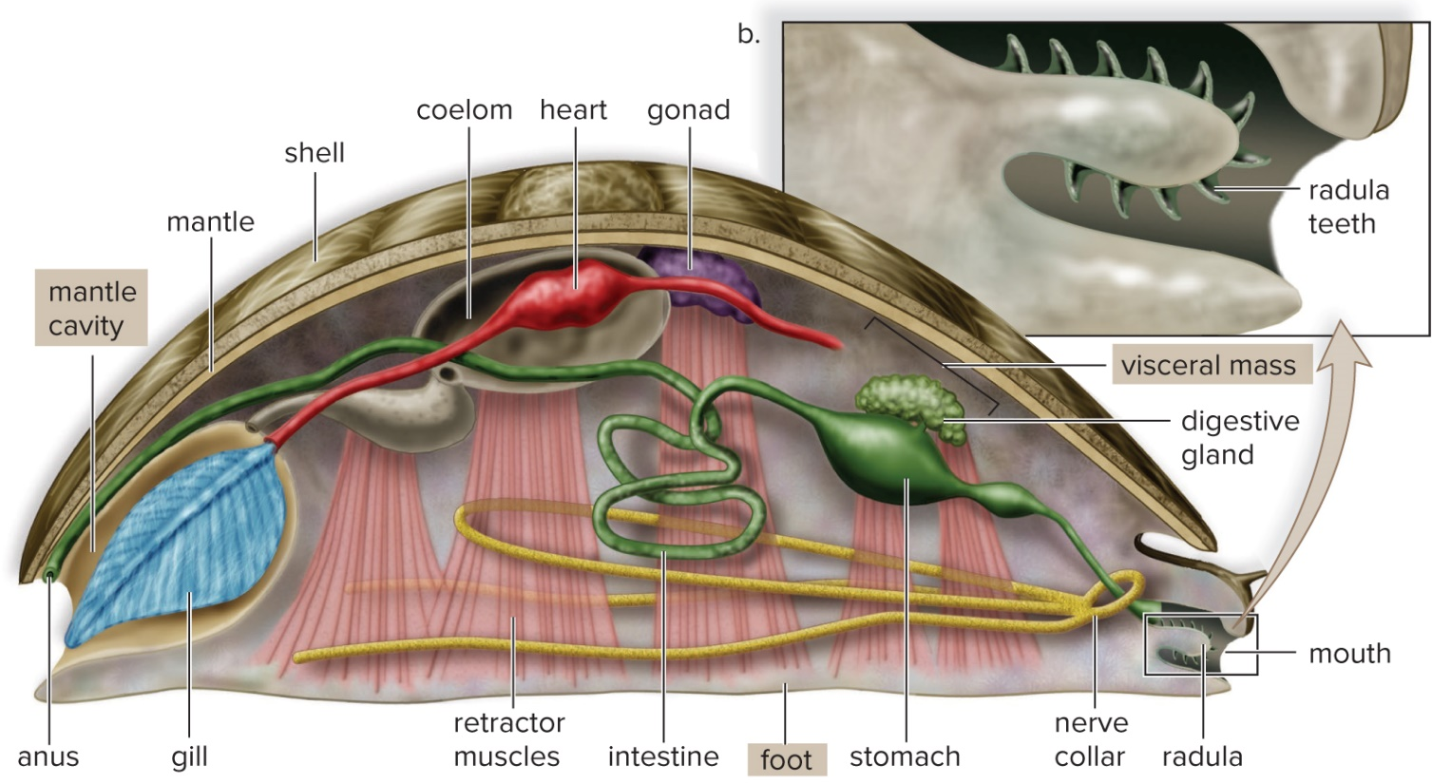
Body Plan of Molluscs
Generalized molluscan anatomy
Figure 28.12
Access the text alternative for slide images.
25

Slide 26
Molluscs
  Nervous system consists of several ganglia connected by nerve cords.
  The true coelom is reduced, and largely limited to the region around the heart.
  Heart pumps hemolymph through vessels into a hemocoel.
26

Slide 27
Bivalves
Bivalves (clams, oysters, mussels, and scallops)
  Shell of two hinged parts, closed by powerful muscles
  No head, no radula
  Little cephalization
  Open circulatory system
  Ciliated gills hang down within the mantle cavity on either side of the visceral mass.
    Beating of cilia causes water to enter the mantle cavity.
    Filter feeders – capture tiny food particles suspended in water
  In freshwater clams
    The sexes are separate
    Fertilization is internal
    Specialized larvae are released from the clam.
27

Slide 28
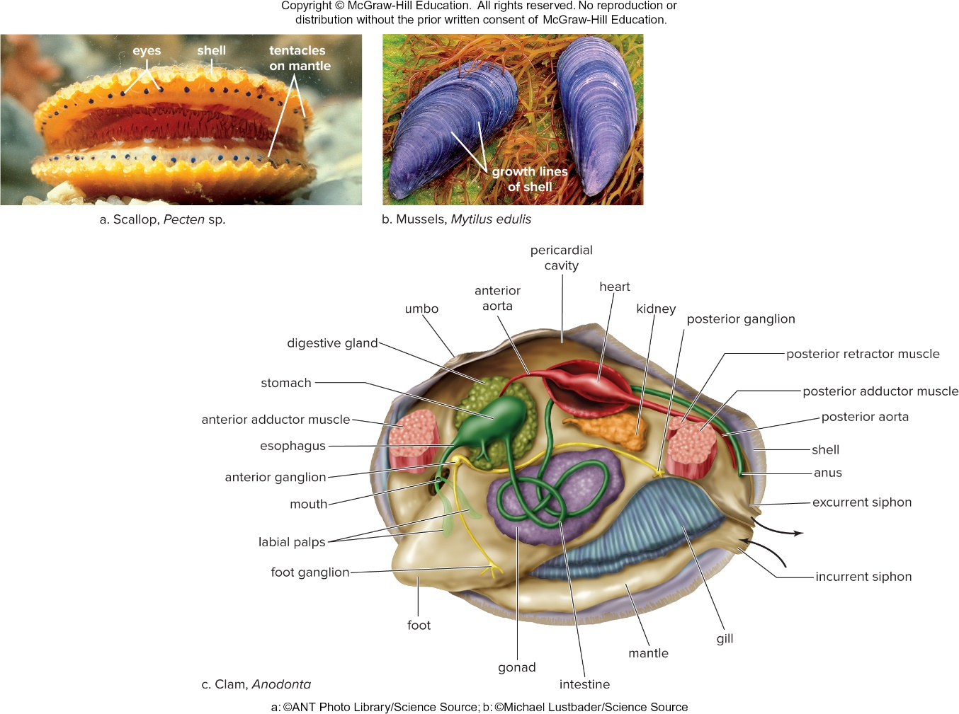
Bivalve Diversity
Figure 28.13
Access the text alternative for slide images.
(a): ANT Photo Library/Science Source; (b): Michael Lustbader/Science Source
28

Slide 29
Other Molluscs
Gastropods
  Largest class of molluscs
  Slugs, snails, whelks, conchs, limpets, nudibranchs
  Have an elongated, flattened foot
  Most have one-piece coiled shell
  Well-developed head region
    Cerebral ganglion and eyes on the ends of tentacles
29

Slide 30
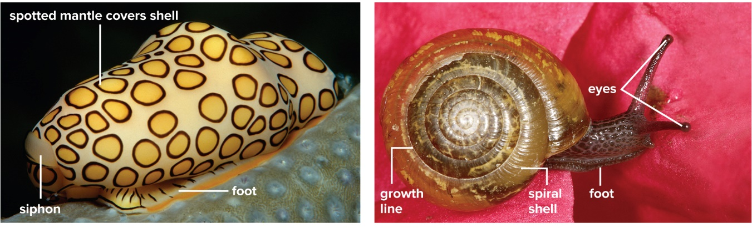
Gastropod Diversity
Flamingo tongue shell, Cyphoma gibbosum
Land snail, Helix aspersa
Figure 28.14
(a): Wolfgang Polzer/Alamy Stock Photo; (b): ©Farley Bridges
30

Slide 31
Cephalopods
  Squids and octopi
  Head-footed
    Force water out mantle cavity for propulsion
  Tentacles and arms capture prey by adhesive secretions or suckers.
  The beak is used to tear prey apart.
  They have well-developed sense organs.
  Octopuses show capacity for learning.
31

Slide 32
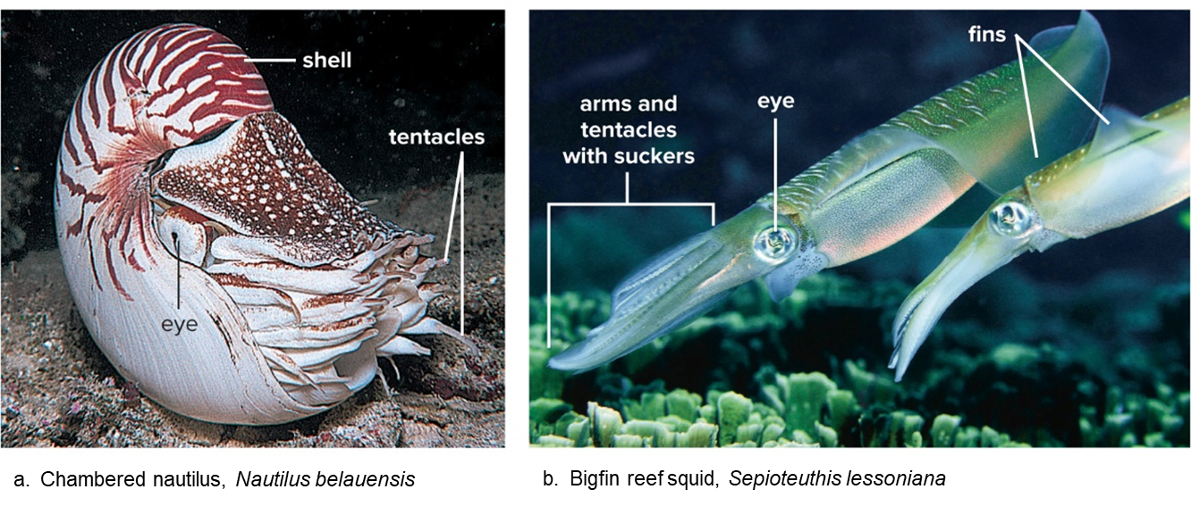
Cephalopod Diversity
Figure 28.15
(a): Douglas Faulkner/Science Source; (b): Georgette Douwma/Science Source
32

Slide 33
Annelids
Annelids (phylum Annelida) are segmented partitions (septa); divide the well-developed, fluid-filled coelom, which acts as a hydrostatic skeleton
  Specialized digestive tract
  Closed circulatory system
  Ventral solid nerve cord
  Most are marine
  Setae (bristles) help in movement
    Oligochaetes have few setae
    Polychaetes have many setae
33

Slide 34
Earthworms
  Setae protrude in pairs directly from surface of body.
  Specialized digestive system
    Food is drawn into the mouth by action of the muscular pharynx.
    Food is stored in a crop and ground up in a gizzard.
    Digestion and absorption occur in a long internal intestine.
      Typhlosole increases the surface for absorption.
    Waste is eliminated through the anus.
34

Slide 35
Earthworm Segmentation
Earthworm segmentation evidenced by:
  Body rings
  Coelom divided by septa
  Setae arranged in pairs on segments
  Ganglionic swellings and lateral nerves in each segment
  Nephridia in each segment
  Branched blood vessels in each segment
35

Slide 36
Earthworm Reproduction
  Hermaphroditic
  Two worms lie in parallel to each other, facing in opposite directions.
    Fused midbody segment (clitellum) secretes mucus, protecting sperm from desiccation.
  There is no larval stage.
36

Slide 37
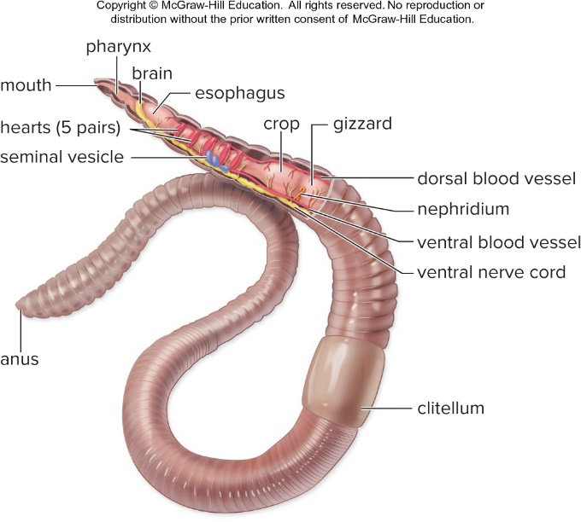
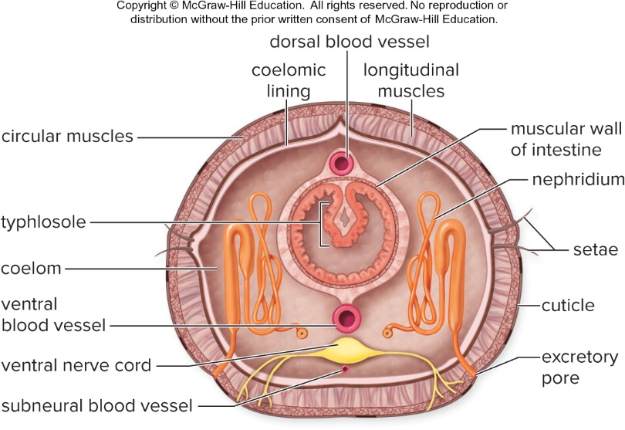
Earthworm, Lumbricus terrestris
Figure 28.16, 28.17
Access the text alternative for slide images.
37

Slide 38
Other Annelids
  Most annelids are marine polychaetes.
    Setae are in bundles on parapodia.
    Clam worms, like Nereis, are predators.
    They have sex organs only during the breeding season.
  Leeches
    Leeches are usually found in freshwater habitats.
    They have the same body plan as other annelids.
      They have no setae.
      Each body ring has several transverse grooves.
      Two additional suckers
        Keep blood flowing and prevent clotting by means of hirudin, a powerful anticoagulant in saliva
38

Slide 39
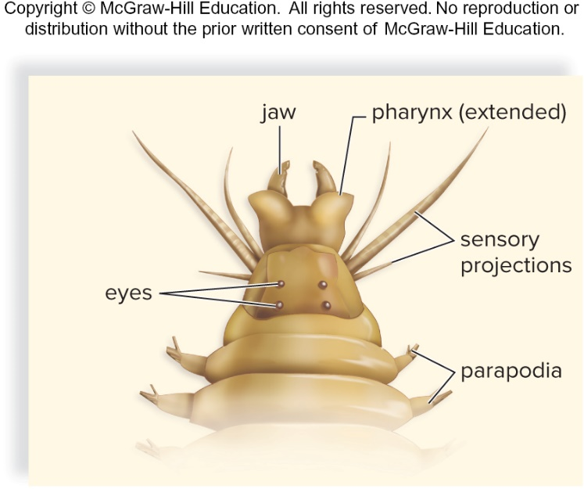
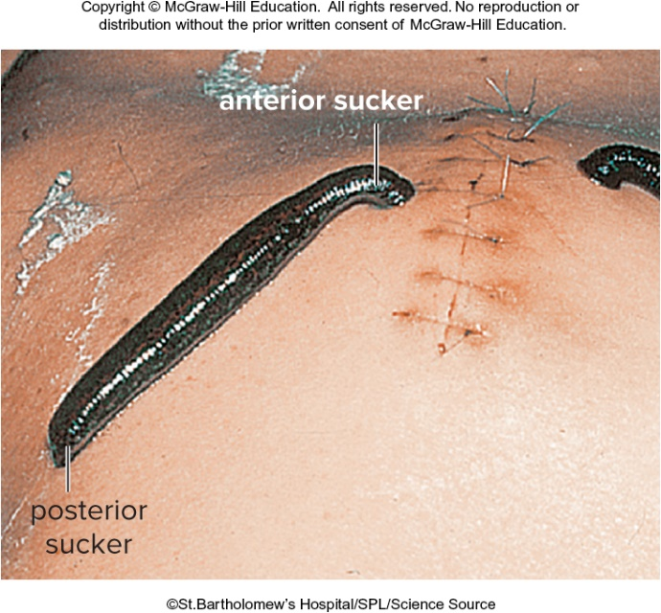
Clam Worms and Leeches
Figure 28.19, 28.21
©St. Bartholomew’s Hospital/SPL/Science Source
39

Slide 40
Flatworms
Flatworms (phylum Platyhelminthes)
  Flat body
  No specialized circulatory or respiratory structures
  Sac body plan with one opening
  No body cavity
40

Slide 41
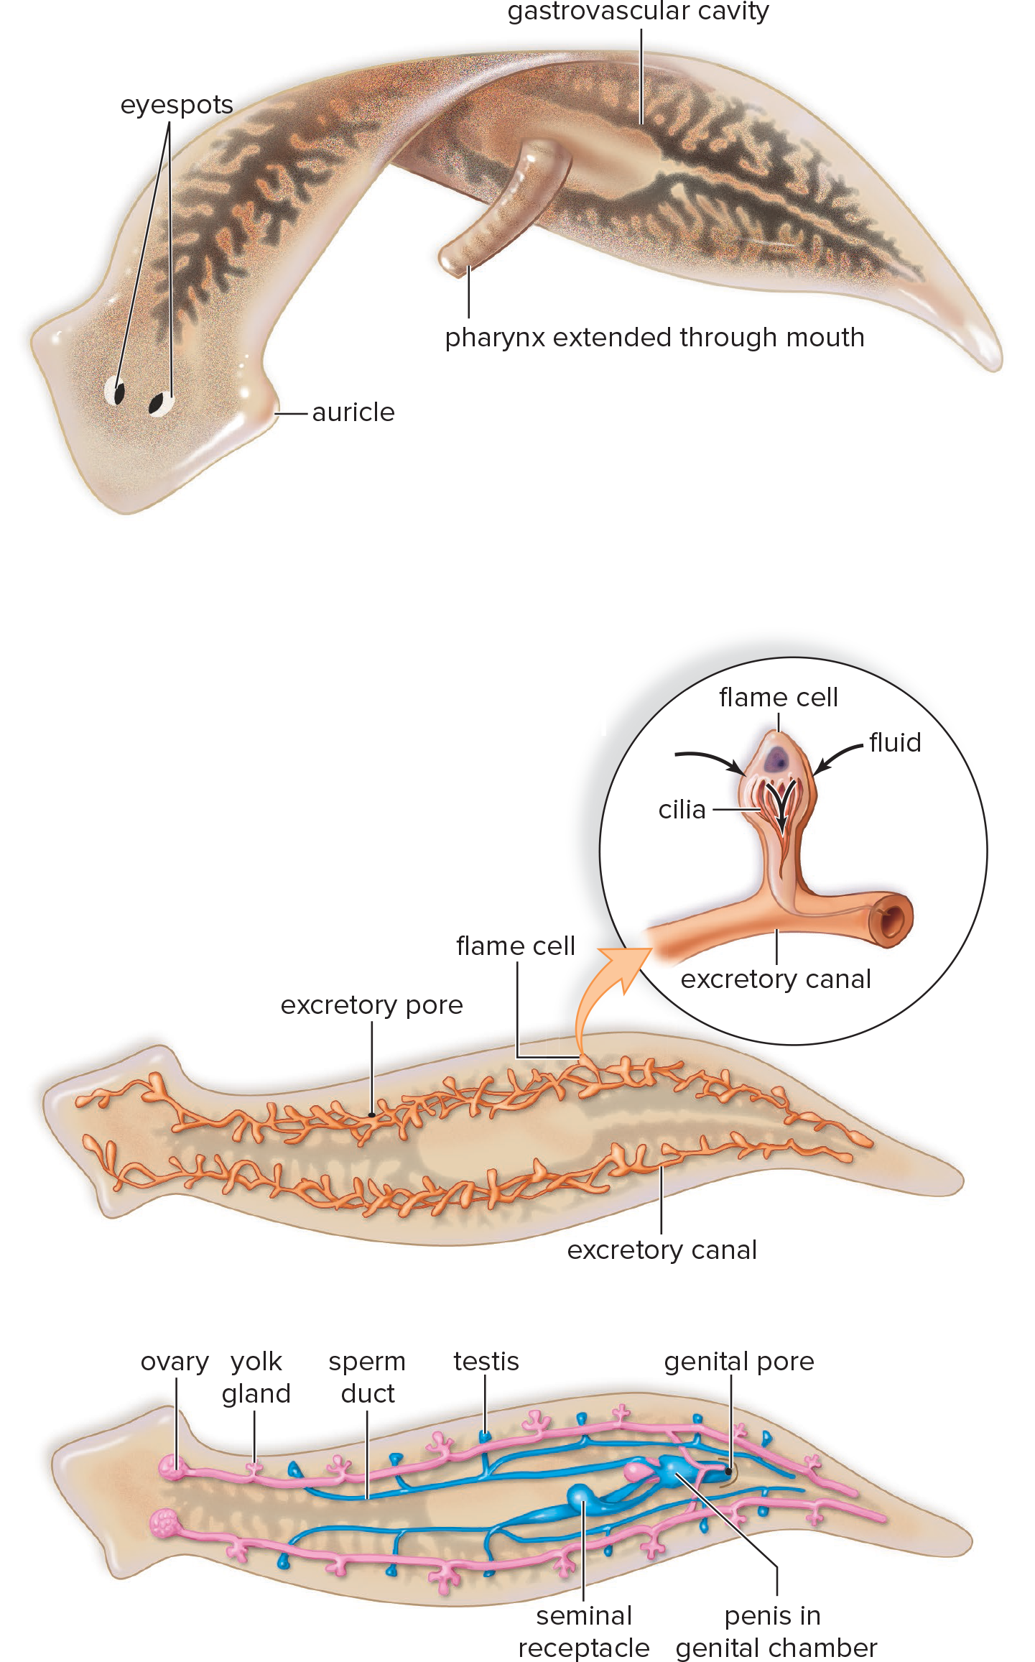
Planarian Digestive System
Figure 28.22, 28.23, 28.24
Access the text alternative for slide images.
41

Slide 42
Planarian Characteristics
Genus Dugesia
  Live in freshwater habitats
  Head bluntly arrow shaped
    Auricles function as sense organs.
    It has two light-sensitive eye spots.
  Ladder-type nervous system
    Paired ganglia function as a primitive brain.
  Three kinds of muscle layers:
    Outer circular layer
    Inner longitudinal layer
    Diagonal layer
42

Slide 43
Planarian Reproduction
Planarian’s excretory organ functions in osmotic regulation and water excretion.
  Can reproduce asexually or sexually
  Hermaphroditic
    Practice cross-fertilization
  Also reproduce asexually by regeneration
  Have undergone cephalization
    The head has lateral extensions with chemosensory and tactile cells.
43

Slide 44
Parasitic Flatworms
Parasitic flatworms are flukes (trematodes) and tapeworms (cestodes).
They both utilize a secondary host to transmit offspring.
  Well-developed nerves and gastrovascular cavity are unnecessary.
  There is a loss of cephalization.
  Head has been replaced by hooks or suckers for attachment to host
Flukes
  Reproductive system well developed
  Usually hermaphroditic
    Schistosoma and Clonorchis sinensis
44

Slide 45
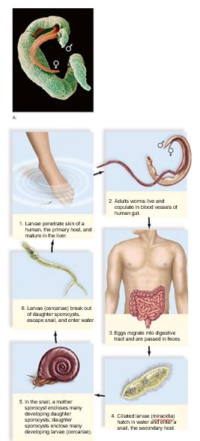
Life Cycle of a Blood Fluke, Schistosoma
Access the text alternative for slide images.
Figure 28.27
(a): SPL/Science Source
45

Slide 46
Tapeworms
  They have anterior region with modifications for attachment to intestinal wall of host.
  Behind the head region, scolex, a long series of proglottids are found that contain a full set of both male and female sex organs.
  Complicated life cycles usually involve several hosts.
    Taenia solium, the pork tapeworm, has the human as a primary host and the pig as a secondary host.
      The cyst contains the tapeworm larva which lodges in muscle.
      Tapeworms interfere with nutrient absorption.
46

Slide 47
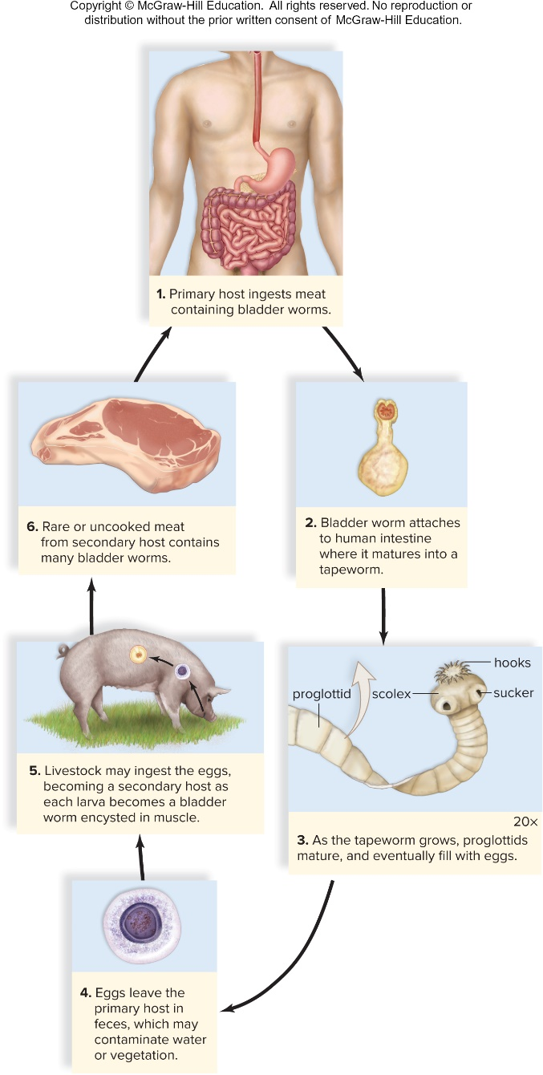
Life Cycle of a Tapeworm, Taenia
Figure 28.28
Access the text alternative for slide images.
47

Slide 48
Rotifers
Phylum Rotifera
  Named for crown of cilia (known as the corona) resembling a rotating wheel
    Serves as both an organ of locomotion and aids direction of food to mouth
  Approximately 2,000 known species
  Mostly freshwater, although some marine and terrestrial forms exist
48

Slide 49
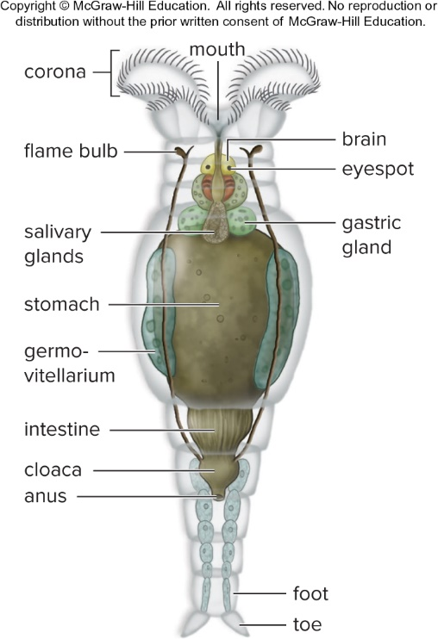
Rotifer
Figure 28.29
Access the text alternative for slide images.
49

Slide 50
28.4 Diversity of the Ecdysozoans
Ecdysis means “stripping off.”
They construct an outer covering called a cuticle.
  Protects and supports animal
  Is shed by molting
The ecdysozoans include roundworms and arthropods.
They have evolved separate sexes.
50

Slide 51
Roundworms
Phylum Nematoda
  Nonsegmented, generally colorless worms
  Several parasitic roundworms infect humans.
  Contain a pseudocoelom:
    A “false” body cavity that is incompletely lined by mesoderm
    Provides a space for internal organs and can serve as hydrostatic skeleton
Caenorhabditis elegans has been used extensively as a model animal in genetics and developmental biology.
51

Slide 52
Parasitic Roundworms
  Ascaris – Intestinal roundworm
    Produces over 200,000 eggs daily
  Trichinella – Trichinosis
    Humans can contract infection from eating rare pork infected with Trichinella.
  Filarial worms – Heartworms
      Causes fatalities in dogs
  Wuchereria – Elephantiasis
      Filarial worm uses mosquitoes as a vector to transmit disease to humans; limbs may swell to a monstrous size.
52

Slide 53
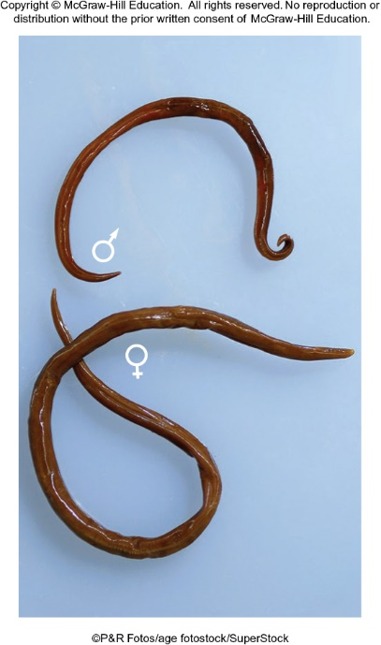
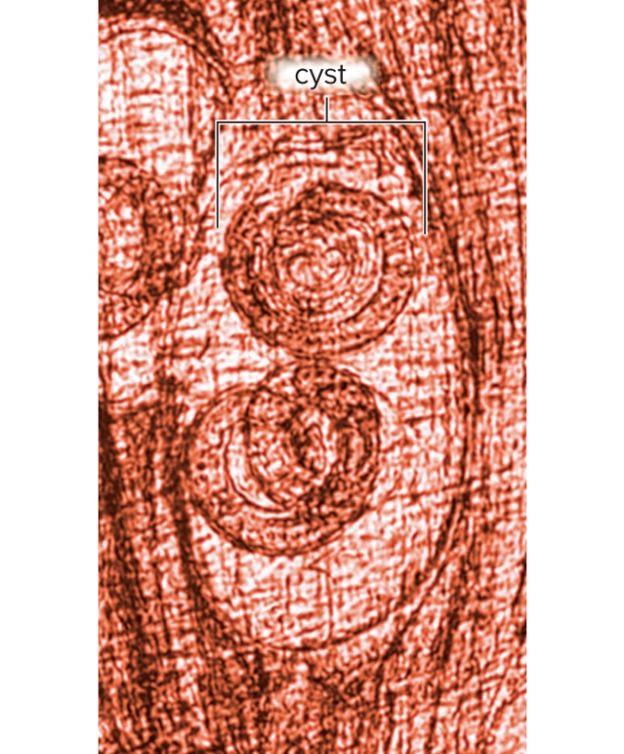
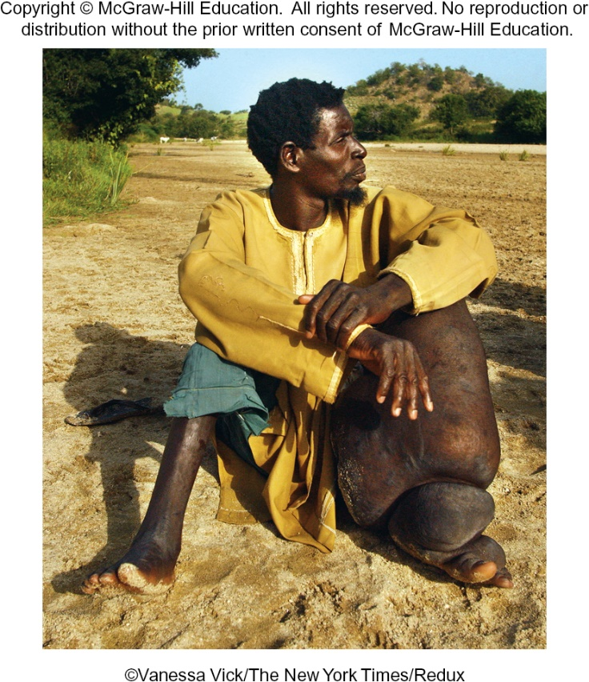
Roundworm Diversity
Figure 28.30
(a): age fotostock/SuperStock; (b): CDC; (c): Vanessa Vick/The New York Times/Redux Pictures
53

Slide 54
Arthropods
Phylum Arthropoda
  Rigid, jointed exoskeleton composed of chitin
    Must molt as they grow
  Segmented, but some segments are fused into regions
    Head, thorax, abdomen
  Well-developed nervous system
    Brain and ventral nerve cord
    Eyes: simple or compound
  Variety of respiratory organs
    Gills, book lungs, tracheae
  Metamorphosis
    Means “implying change of shape or form”
    Reduces competition because larvae require different food and environment than adults
54

Slide 55
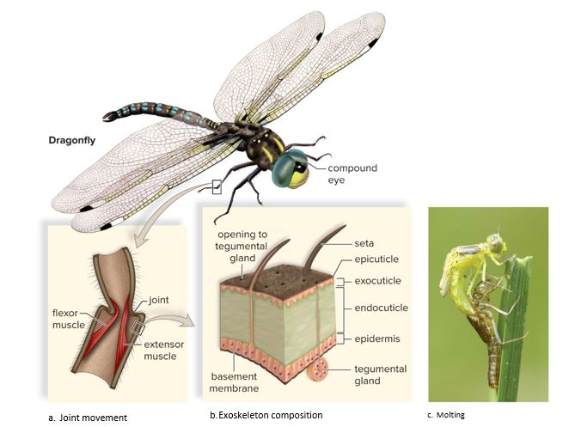
Arthropod Skeleton and Molting
Figure 28.31
Access the text alternative for slide images.
(c): TommyIX/Getty Images
55

Slide 56
Crustaceans
  Possess crusty exoskeleton (calcium carbonate/chitin)
  Most crustaceans have compound eyes and five pairs of appendages.
  Majority of crustaceans live in marine and aquatic environments.
  Decapods are the most familiar and numerous of crustaceans.
    Shrimp, lobsters, crayfish, and crabs
  Copepods and krill are small, free-swimming crustaceans that live in water and feed on algae.
  Barnacles are commonly noted living on wharf pilings.
56

Slide 57
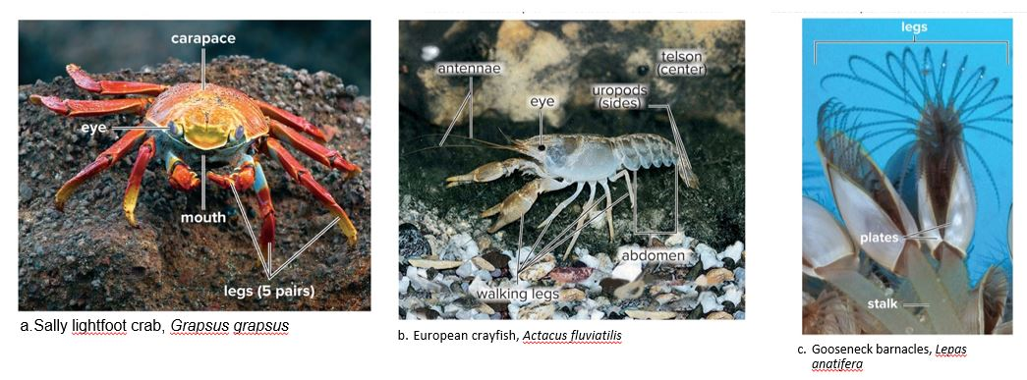
Crustacean Diversity
Figure 28.33
Access the text alternative for slide images.
(a): Michael Lustbader/Science Source; (b): DEA/C. Galasso/De Agostini Picture Library/Getty Images; (c): L. Newman & A. Flowers/Science Source
57

Slide 58
Crayfish
  Thorax bears five pairs of walking legs.
  Head and thorax fused into cephalothorax
    Covered by nonsegmented carapace
    Abdominal segments equipped with swimmerets
  The respiratory system consists of gills.
  Coelom is reduced.
  They have an open circulatory system.
  The nervous system is well-developed.
  The sexes are separate.
  Green glands excrete metabolic wastes.
58

Slide 59
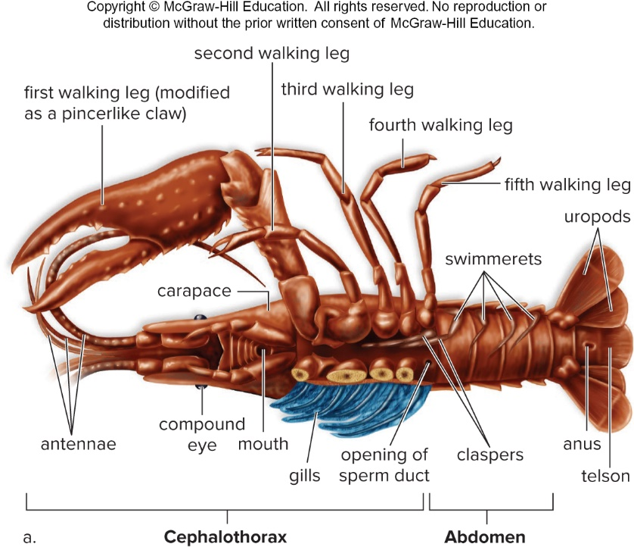
Male Crayfish, Cambarus
Figure 28.34a
Access the text alternative for slide images.
59

Slide 60
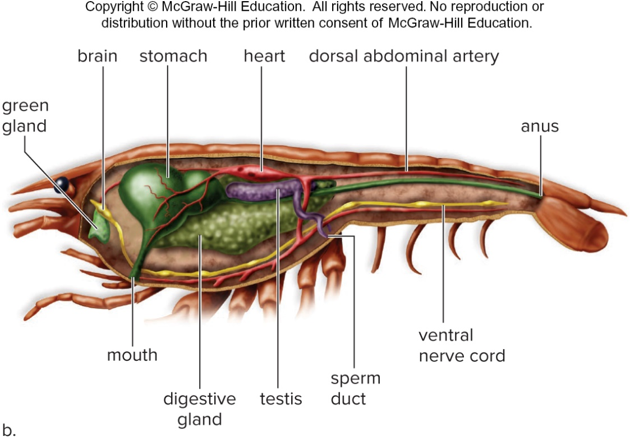
Cross-Section for Male Crayfish, Cambarus
Figure 28.34b
Access the text alternative for slide images.
60

Slide 61
Centipedes and Millipedes
Centipedes
  “Centipede” means hundred legs.
  Each body segment has a pair of walking legs.
  They live in moist environments.
  The head includes paired antennae and mandibles.
  Appendages on the first trunk segment are jaws that kill or immobilize prey.
Millipedes
  Four thoracic segments each have one pair of legs.
  Abdominal segments have two pairs of legs.
  They have cylindrical bodies.
  They have a tough chitinous exoskeleton.
61

Slide 62
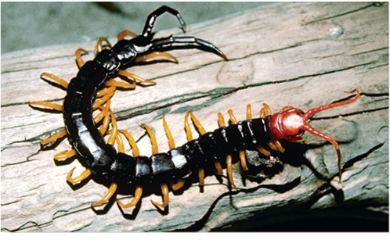
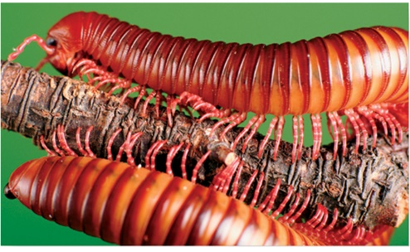
Centipede and Millipede
Figure 28.35
(a): Larry Miller/Science Source; (b) David Aubrey/The Image Bank/Getty Images
62

Slide 63
Insects
  Most insects live on land.
  Body segments
    Head bears sense organs and mouthparts.
    Thorax bears three pairs of legs and sometimes one or two pairs of wings.
    Abdomen contains most internal organs.
  Many insects undergo complete metamorphosis.
    Body parts are completely reorganized.
  They live on land and breathe by tracheae.
  Insects are an important food source for other animals and carnivorous plants.
63

Slide 64
A Typical Insect: Grasshopper
  Third pair of legs is for jumping.
  First abdominal segment bears a tympanum.
  Posterior region of exoskeleton of female has ovipositor.
  Food is stored in crop before passing to gizzard.
  The excretory system consists of Malpighian tubules.
  The respiratory system begins with openings in exoskeleton called spiracles.
    From spiracles, air enters tracheae.
    Breathing through tracheae may account for the small size of insects.
  The circulatory system consists of a slender, tubular heart.
  They undergo incomplete metamorphosis.
    Gradual change in form.
64

Slide 65
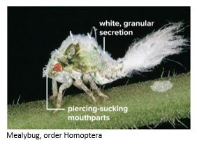
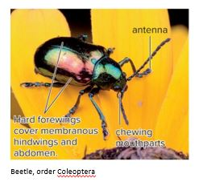
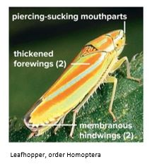
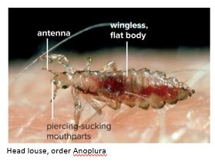
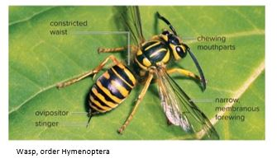
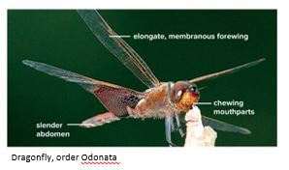
Insect Diversity
Figure 28.36
Access the text alternative for slide images.
(mealbug): ©Farley Bridges; (beetle): George Grall/Getty Images; (leafhopper): ©Farley Bridges; (louse): Alastair Macewen/Oxford Scientific/Getty Images; (wasp): James H. Robinson/Science Source; (dragonfly): ©Farley Bridges
65

Slide 66
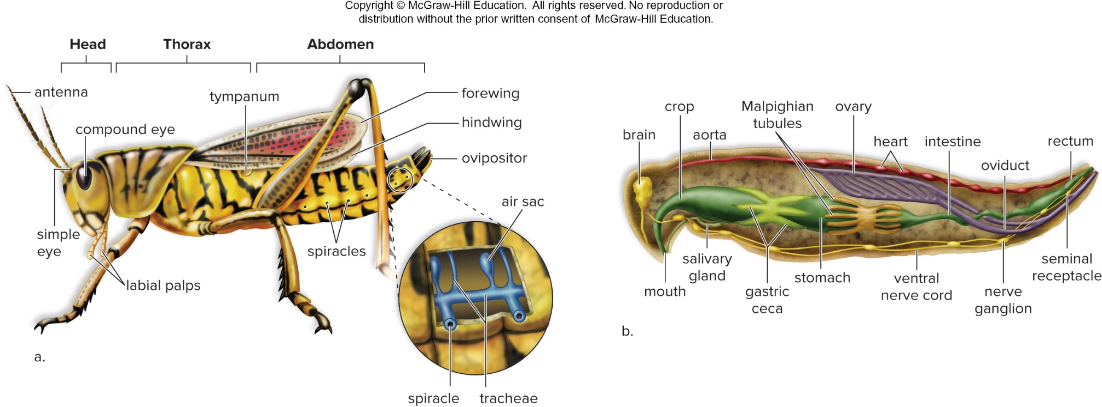
Female Grasshopper, Romalea
Figure 28.37
Access the text alternative for slide images.
66

Slide 67
Chelicerates
  Live in terrestrial, aquatic, and marine environments
  Include terrestrial spiders, scorpions, ticks, mites, horseshoe crabs, and sea spiders
  Over 35,000 species of spiders and over 1,500 species of scorpions have been identified.
  All appendages attached to cephalothorax, none on abdomen
    First pair (chelicerae) are used for feeding and defense.
    Second pair (pedipalps) function in feeding or sensory systems.
67

Slide 68
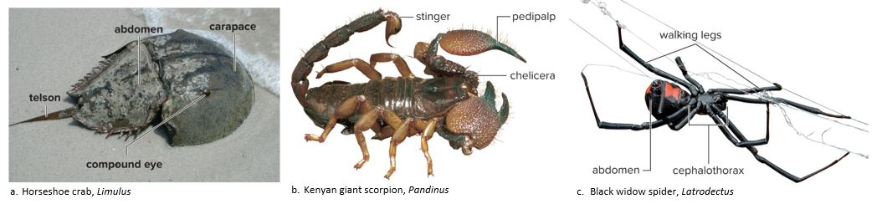
Chelicerate Diversity
Figure 28.38
Access the text alternative for slide images.
(a): Source: Robert Pos/U.S. Fish & Wildlife Service; (b): Tom McHugh/Science Source; c: Mark Kostich/Getty Images
68

Slide 69
28.5 Invertebrate Deuterostomes
  Echinoderms (phylum Echinodermata)
    Invertebrate deuterostomes
    Sea stars, sea urchins, sea cucumbers, and sand dollars
    Radial symmetry as adults
    Bilateral symmetry as larvae
    Endoskeleton made of calcium-rich plates with spines
    Central nerve ring with branches
    Water vascular system for locomotion, feeding, gas exchange, and sensory reception
69

Slide 70
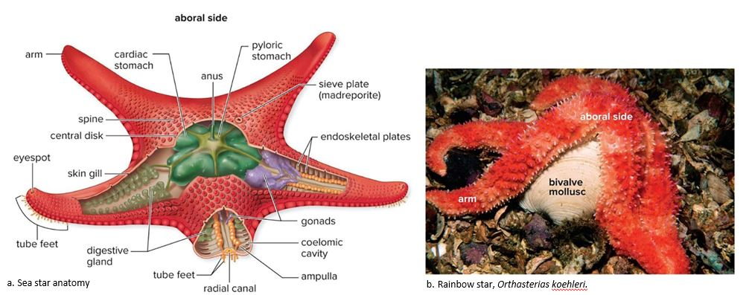
Echinoderm Anatomy
Figure 28.39
Access the text alternative for slide images.
(b): Mark Conlin/Alamy Stock Photo
70

Slide 71
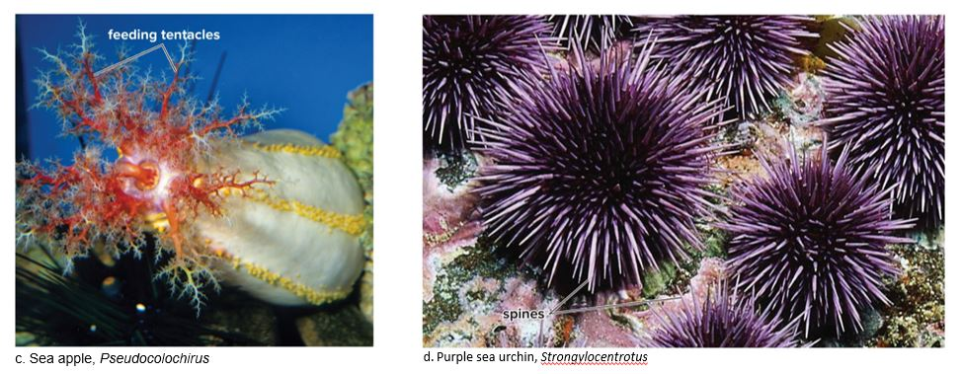
Echinoderm Examples
Figure 28.39
Access the text alternative for slide images.
(c): Roberto Nistri/Alamy Stock Photo; (d): Fuse/Getty Images
71

Slide 72
A Typical Echinoderm: Sea Star
  Spines from exoskeletal plates offer protection.
  On oral surface, each arm has a groove lined by little tube feet.
    Tube feet are used to open clams, oysters, and bivalves.
  Locomotion depends on water vascular system.
    Water enters through the sieve plate and passes through a series of canals.
    Contraction of an ampulla forces water into the tube foot.
    Expansion and contraction of tube feet allow movement.
    Echinoderms have no respiratory, excretory, or circulatory system.
  Sea stars reproduce sexually and asexually.
72

Slide 73
End of main content
Copyright 2022 © McGraw Hill LLC. All rights reserved. No reproduction or distribution without the prior written consent of McGraw Hill LLC.

Slide 74
Accessibility Content: Text Alternatives for Images

Slide 75
Hypotheses on the Evolution of Early Animals - Text Alternative
Return to parent-slide containing images.
Earliest animals (sponges):
Evidence: Sponges contain choanocyte cells which resemble choanoflagellates.
The data leads to each other as follows:
1. Choanoflagellate, ancestral cell.
2. Aggregation of similar cells forms a hollow sphere.
3. Specialization occurs in some cells.
Earliest animals (sponges):
Evidence: Sponges contain archaeocyte cells, which can become specialized into various cell types. These cells contain genes similar to those of single-celled organisms that also exhibit complex life cycles.
The details leads to each other as follows:
1. Ancestral cell.
2. Aggregation of cells exhibiting complex life cycles.
3. Some cells pause during the life cycle, allowing
for a diversity of cell types.
Return to parent-slide containing images.

Slide 76
Protostomes Compared to Deuterostomes - Text Alternative
Return to parent-slide containing images.
The data for cleavage in protostomes and deuterostomes are as follows:
Cleavage: Protostomes: top view and side view shows cleavage is spiral and determinate.
Cleavage: Deuterostomes: top view and side view shows cleavage is radial and indeterminate.
The data for fate of blastopore in protostomes and deuterostomes are as follows:
Fate of blastopore: Protostomes: Blastopore with primitive gut and blastopore with mouth and anus where blastopore becomes mouth.
Fate of blastopore: Deuterostomes: Blastopore with primitive gut and blastopore with mouth and anus where blastopore becomes the anus.
The data for fate of coelom formation in protostomes and deuterostomes are as follows:
Coelom formation: Protostomes: Blastopore shows mesoderm leading to blastopore with gut in the center where coelom forms by a splitting of the mesoderm.
Coelom formation: Deuterostomes: Blastopore shows mesoderm leading to blastopore with gut in the center where coelom forms by an outpocketing of primitive gut.
Return to parent-slide containing images.

Slide 77
Sponge Anatomy - Text Alternative
Return to parent-slide containing images.
A) Yellow tube sponge, Aplysina fistularis:
Diagram shows a cylindrical porous body with textured external surface.
B) Sponge organization:
Diagram shows water passing through the pores, inner surface of osculum, central cavity and pores through which water oozes out.
C) Enlarged diagram of sponge wall shows a three spiked spicule, pore, ovular amoebocyte and epidermal cell.
D) Enlarged diagram of collar cell (choanocyte) shows irregular shaped amoebocyte, ovular nucleus and projections of collar and elongated flagellum.
Return to parent-slide containing images.

Slide 78
Anatomy of Hydra - Text Alternative
Return to parent-slide containing images.
A) Diagram shows long tentacle with pit-like mouth of hydra, gastrovascular cavity and nerve net at the bottom.
B) Diagram shows a green bud with branches against a black surface.
C) Diagram shows tissue layers of hydra with gastrovascular cavity, projections of flagella, mesoglea (packing material), ovoid gland cell and sensory cell, cnidocyte and nematocyst.
Return to parent-slide containing images.

Slide 79
Body Plan of Molluscs - Text Alternative
Return to parent-slide containing images.
A) Generalized molluscan anatomy:
The anatomy of semi-circular mollusc shows anus, mantle cavity, mantle, shell, coelom, heart, gonad, visceral mass, digestive gland, mouth, radula, nerve collar, stomach, foot, intestine, retractor muscles, gill and anus.
B) Diagram shows spiked radula teeth across the mouth.
Return to parent-slide containing images.

Slide 80
Bivalve Diversity - Text Alternative
Return to parent-slide containing images.
A) Scallop, Pecten sp:
Double disc-like surface shows spots of black across the circumference representing eyes, hard shell and tentacles on mantle.
B) Mussels, Mytilus edulis:
Two cylindrical structures with tip shows growth lines of shell.
C) Clam, Anodonta:
The structure is labeled clockwise as: pericardial cavity, ovular heart, triangular kidney, thin posterior ganglion, ovular and raised posterior retractor muscle, posterior adductor muscle, tube like posterior aorta, external shell, anus, excurrent siphon, incurrent siphon, laterally textured gill, thick mantle, coiled intestine, ovular gonad, pointed foot, foot ganglion, tube like labial palps, ovular mouth, bulb-shaped anterior ganglion, esophagus, raised circular anterior adductor muscle, ovular stomach, spherically textured digestive gland, raised external umbo and anterior aorta.
Return to parent-slide containing images.

Slide 81
Earthworm, Lumbricus terrestris - Text Alternative
Return to parent-slide containing images.
The diagram from top to bottom shows a pointed mouth, pharynx, brain, esophagus, five pairs of hearts, seminal vesicle, crop, gizzard, dorsal blood vessel, nephridium, ventral blood vessel, ventral nerve cord, inflated and smooth clitellum and anus.
The diagram of an earthworm is labeled clockwise as: circular dorsal blood vessel, longitudinal muscles, circular muscular wall of intestine, folded nephridium, projections of setae, outer layered cuticle, excretory pore, dot-like subneural blood vessel, ovoid ventral nerve cord, circular ventral blood vessel, coelom, ovular typhlosole and outer circular muscles.
Return to parent-slide containing images.

Slide 82
Planarian Digestive System - Text Alternative
Return to parent-slide containing images.
The head has an two eyespots, which are light-sensitive cups containing pigment on the inner sides. Also located on the head are chemosensitive organs on each auricle, which is a bulge on the side of the head. The digestive system consists of a gastrovascular cavity that branches extensively throughout the body and a tube-like pharynx that emerges from the mouth on the underside of the middle of the body. A planarian extends its pharynx to suck food into the gastrovascular cavity, which has one branch extending from the mouth toward the head and two branches extending down the body from either side of the pharynx. The excretory system of the planarian consists of tubules called excretory canals that branch throughout both sides of the body. Excretory pores occur at intervals along the canals. Blunt extensions of the canals contain flame cells with cilia. The beating of the cilia in the flame cells draws fluid into the extensions, throughout the canals, and toward the excretory pores. The reproductive system is hermaphroditic: a single individual contains both female and male reproductive structures. The female reproductive structures consist of two tubules that extend on either side of the flatworm and have short, branched clusters called yolk glands at intervals. At the anterior end, each tubule ends in an ovary. Near the posterior end, side branches from both tubules connect in the middle and empty into the genital pore. The male structures consist of tubules called sperm ducts that extend along either side of the body and have testes at intervals. Above the genital pore, a seminal receptacle connects to the genital chamber that contains a penis.
Return to parent-slide containing images.

Slide 83
Life Cycle of a Blood Fluke, Schistosoma - Text Alternative
Return to parent-slide containing images.
Steps in the life cycle include: 1. Larvae penetrate skin of a human, the primary host, and mature in the liver. 2. Adult worms live and copulate in blood vessels of human gut. 3. Eggs migrate into digestive tract and are passed in feces. 4. Ciliated larvae (miracidia) hatch in water and enter a snail, the secondary host. 5. In the snail, a mother sporocyst encloses many developing daughter sporocysts; daughter sporocysts enclose many developing larvae (cercariae). 6. Larvae (cercariae) break out of daughter sporocysts, escape the snail, and enter water.
Return to parent-slide containing images.

Slide 84
Life Cycle of a Tapeworm, Taenia - Text Alternative
Return to parent-slide containing images.
1. Primary host ingests meat containing bladder worms. 2. Bladder worm attaches to human intestine where it matures into a tapeworm. 3. As the tapeworm grows, proglottids mature, and eventually fill with eggs. 4. Eggs leave the primary host in feces, which may contaminate water or vegetation. 5. Livestock may ingest the eggs, becoming a secondary host as each larva becomes a bladder worm encysted in muscle. 6. Rare or uncooked meat from secondary host contains many bladder worms.
Return to parent-slide containing images.

Slide 85
Rotifer - Text Alternative
Return to parent-slide containing images.
Upper body:
It consists of pair of spiked corona, mouth in between them, small ovular flame bulb, brain with eyespot within it on each longitudinal side, bulb-like salivary glands and spherical gastric glands.
Central body:
It consists of a large spherical stomach and layer of germovitellariumon two sides.
Lower body:
It consists of cup-like intestine and cloaca extending into a tip of anus, long laterally segmented pair of foot and ovular pair of toes with tips.
Return to parent-slide containing images.

Slide 86
Arthropod Skeleton and Molting - Text Alternative
Return to parent-slide containing images.
A) Joint movement:
Diagram shows a longitudinal flexor muscle connected at the edges of joins extending into thicker extensor muscle.
B) Exoskeleton composition:
Diagram of a section of exoskeleton of leg shows pores of opening to tegumental gland, seta projections, epicuticle (first layer of skin), exocuticle (second layer of skin), endocuticle (second layer of skin), segmented layer of epidermis, circular tegumental gland and last layer of basement membrane.
C) Molting:
A dragonfly casting off part of its skin over a green branch.
Return to parent-slide containing images.

Slide 87
Crustacean Diversity - Text Alternative
Return to parent-slide containing images.
A) Sally light foot crab (Grapsus grapsus):
The body shows an external shell-like carapace, a pair of eyes on either sides, mouth and five pair of legs.
B) European crayfish (Actacus fluviatilis):
The body shows a pair of antennae, spot-like eye, uropods on sides and telson in the center, longitudinally segmented abdomen and four walking legs.
C) Gooseneck barnacles (Lepas anatifera):
The body shows longitudinal stalk, leaf-shaped plates and numerous legs.
Return to parent-slide containing images.

Slide 88
Male Crayfish, Cambarus - Text Alternative
Return to parent-slide containing images.
A) Cephalothorax:
The cephalothorax of male cray fish consists of antennae projections, pair of compound eye on either sides, circular mouth, curved gills, opening of sperm duct, carapace, first walking leg (modified as a pincer like claw), second walking leg (curved to left), third walking leg (curved to left), fourth walking leg (curved to right) and fifth walking leg (curved to right).
Abdomen:
The abdomen of male cray fish consists of pair of claspers, longitudinally fragmented swimmerets, leaf-shaped uropods, spot of anus and broad telson.
Return to parent-slide containing images.

Slide 89
Female Grasshopper, Romalea - Text Alternative
Return to parent-slide containing images.
A) The body is divided into head, thorax and abdomen with the following parts:
Head: It consists of a pair of antenna, compound and simple eyes with laterally segmented labial palps.
Thorax: It consists of cylindrical tympanum in the center.
Abdomen: It consists of a pair of forewings and hindwings with ovipositor projection, air sac (consisting of spiracle and tracheae tubules), spots of spiracles.
B) The digestive system of female grasshopper consists of ovular brain, tube-like mouth, tube of crop, sac-like salivary gland, lateral tubule of aorta, multiple malpighian tubules, textured ovary, stomach sac, spot-like heart, ventral nerve cord, tubule-like intestine, oviduct, nerve ganglion, tubule-like seminal receptacle and rectum.
Return to parent-slide containing images.

Slide 90
Chelicerate Diversity - Text Alternative
Return to parent-slide containing images.
A) Horseshoe crab (Limulus):
The body shows a carapace and compound eye in the front with an external abdomen in the center and pointed telson at the back.
B) Kenyan giant scorpion (Pandinus):
The body shows chelicera and pointed pedipalp in the front with stinger at the back.
C) Black widow spider (Latrodectus):
The body shows cephalothorax in the center with large abdomen at the back and a pair of four walking legs.
Return to parent-slide containing images.

Slide 91
Cross-Section for Male Crayfish, Cambarus - Text Alternative
Return to parent-slide containing images.
B) The digestive system of male cray fish consists of green irregularly ovular gland, cord-like brain, stomach sac, lateral cord-like heart extending into dorsal abdominal artery, anus at the end, lateral ventral nerve cord, sperm duct projection, ovoid testis, spherically textured digestive gland and tube-like mouth.
Return to parent-slide containing images.

Slide 92
Insect Diversity - Text Alternative
Return to parent-slide containing images.
A) Mealybug, order Homoptera:
The back of the body shows white, granular secretion while the front of the body shows piercing-sucking mouthparts.
B) Beetle, order Coleoptera:
The body shows a pair of antennae, hard forewings cover membranous hindwings and abdomen in the center and chewing mouthparts.
C) Leafhopper, order Homoptera:
The body shows piercing-sucking mouthparts in the front, pair of thickened forewings in the center and a pair of membranous hindwings at the back.
D) Head louse, order Anoplura:
The body shows a pair of antenna and piercing-sucking mouthparts in the front and wingless, flat body in the center.
E) Wasp, order Hymenoptera:
The body shows chewing mouthparts in the front, constricted waist and narrow, membranous pair of forewings in the center and an ovipositor and stinger at the back.
F) Dragonfly, order Odonata:
The body shows chewing mouthparts in the front, elongate, membranous pair of forewings in the center and a slender abdomen
at the back.
Return to parent-slide containing images.

Slide 93
Echinoderm Anatomy - Text Alternative
Return to parent-slide containing images.
A) Sea star anatomy:
Aboral side diagram of sea star shows a pair of arms, tube feet projections, flower-shaped cardiac and pyloric stomach and anus within it, sieve plate (madreporite), spine, central disk, eyespot, skin gill, endoskeletal plates, longitudinal gonads, coelomic cavity, radial canal and spherically textured digestive gland.
B) Rainbow star (Orthasterias koehleri):
The body shows an aboral side, bivalve mollusc in the center and multiple arms surrounding it.
Return to parent-slide containing images.

Slide 94
Echinoderm Examples - Text Alternative
Return to parent-slide containing images.
C) Sea apple (Pseudocolochirus):
The body shows feeding tentacles across the surface.
D) Purple sea urchin (Strongylocentrotus):
The body shows longitudinal spines across the surface.
Return to parent-slide containing images.

